Slide 1
Sampling Distributions
Parameter | Population | Sample
Size | N | n
Mean | µ
Standard deviation | σ | s
Proportion | π | ρ
Sampling?
In this presentation we will explore the concept of taking a sample from a population.
The types of statistics that we explored within earlier chapters are statistics that provide an answer to a particular question, where we assume that the data collected is from the complete population. In many situations this is not the case, and the data collected represents a sample from a population being measured.

Slide 2
Learning objectives
On completing this chapter, you should be able to:
Distinguish between the concept of a population and sample.
Understand the concept of a sampling distribution: mean and proportion.
Understand sampling from a normal population.
Understand sampling from non-normal population – Central Limit Theorem.
Estimate an appropriate sample size given the confidence interval.
Solve problems using Microsoft Excel and IBM SPSS software packages.

Slide 3
Introduction to the concept of a sample
Population
Sample
Parameter
Is a summary measure that describes a characteristic of the population
Statistic
Is a summary measure that describes a characteristic of the sample
Sample data values taken from the population
All data values

Slide 4
Why sample?
Sampling is usually collected via survey instruments, but could also be achieved by observation, archival record, or other method.
What is important to realise is that no matter what method is used to collect the data values, the purpose is to determine how much and how well the data set can be used to generalise the findings from the sample to the population.
It is important to avoid data collection methods that maximise the associated errors and a bad sample may well render findings meaningless.
Questions we should answer are:
How well does the sample represent the larger population from which it was drawn?
How closely do the features of the sample resemble those of the larger population?

Slide 5
Sampling terminology
A few statements hold true in general when dealing with sampling:
Samples are always drawn from a population
The population to be sampled should coincide with the population about which information is wanted (the target population)
Before selecting the sample, the population must be divided into parts that are called sampling units. These units must cover the whole of the population and they must not overlap, in the sense that every element in the population belongs to one and only one unit.
The development of this list of sampling units, called a frame, is often one of the major practical problems. The frame is a list that contains the population list of what you like would to measure.
The final stage is to collect the sample using either probability or non probability sampling described below.

Slide 6
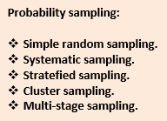
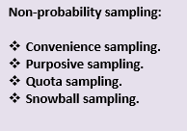
Types of sampling
Within this text we will assume that the samples are all random samples.

Slide 7
Sampling from a population
When we wish to know something about a particular population it is usually impractical, especially when considering large populations, to collect data from every unit of that population. It is more efficient to collect data from a sample of the population under study and from the sample make estimates of the population parameters. Essentially, based on a sample, we make generalisations about a population.
Population - a complete set of counts or measurements derived from all objects possessing one or more common characteristic, such as height, age, sales, income etc. Measures such as means and standard deviations derived from the population data are known as population parameters.
Sample - a proportion of a population under study derived from sample data. Measures such as means and standard deviations are known as sample statistics or estimators.

Slide 8
Sampling distributions
The main issue that we shall shortly explore is that we wish to collect a sample (or samples) from a population and use this sample to provide an estimate of the population parameters (mean, standard deviation, proportion by using the sample parameter value (sample mean, sample proportion, and sample standard deviation).
Sampling Distributions
Sampling distributions of the mean
Sampling distributions of the proportion
A sampling distribution is a distribution of all the possible values of a statistic for a given sample size selected from a population.

Slide 9
Sampling distribution of the mean
In this section we will explore what we mean by the sampling distribution of the mean.
Let’s assume that a sample of size 200 is taken and that the average weight is 135.5 kgs. Another sample is taken and the mean weight is 132.5 kgs. A large number of samples might be taken and the sample means calculated.
Obviously, these means are unlikely to be equal and they can be plotted as a frequency distribution of the mean.
What is really important here is that the mean of all the sample means has some interesting properties. It is identical to the overall population mean.
A sample mean is unbiased since the mean of all sample means of size n selected from the population is equal to the population mean, µ.

Slide 10
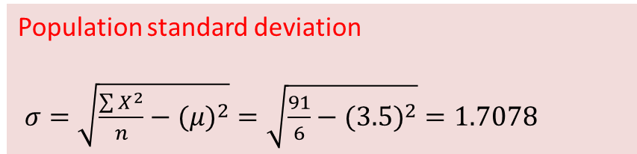
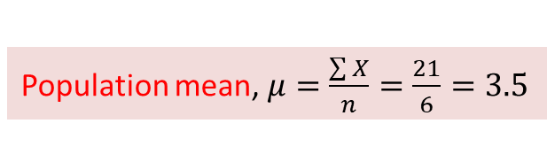
Example 4.5 (1/7)
To illustrate this property consider the problem of tossing a fair die. The die has 6 numbers (1, 2, 3, 4, 5, and 6) with each number likely to have the same frequency of occurrence. If we then take all possible samples of size 2 from this population then we will be able to illustrate two important results of the sampling distribution of the sample means.
Population data
From the population data values (1, 2, 3, 4, 5, and 6) we can calculate the population mean and standard deviation using equations (4.1) and (4.2):
X | X²
1 | 1
2 | 4
3 | 9
4 | 16
5 | 25
6 | 36
Population mean, $μ=\frac{\sum{X}}{n}=\frac{21}{6}=3.5$
Population standard deviation
$σ=\sqrt{\frac{\sum{X^{2}}}{n}−(μ)^{2}}=\sqrt{\frac{91}{6}−(3.5)^{2}}=1.7078$

Slide 11
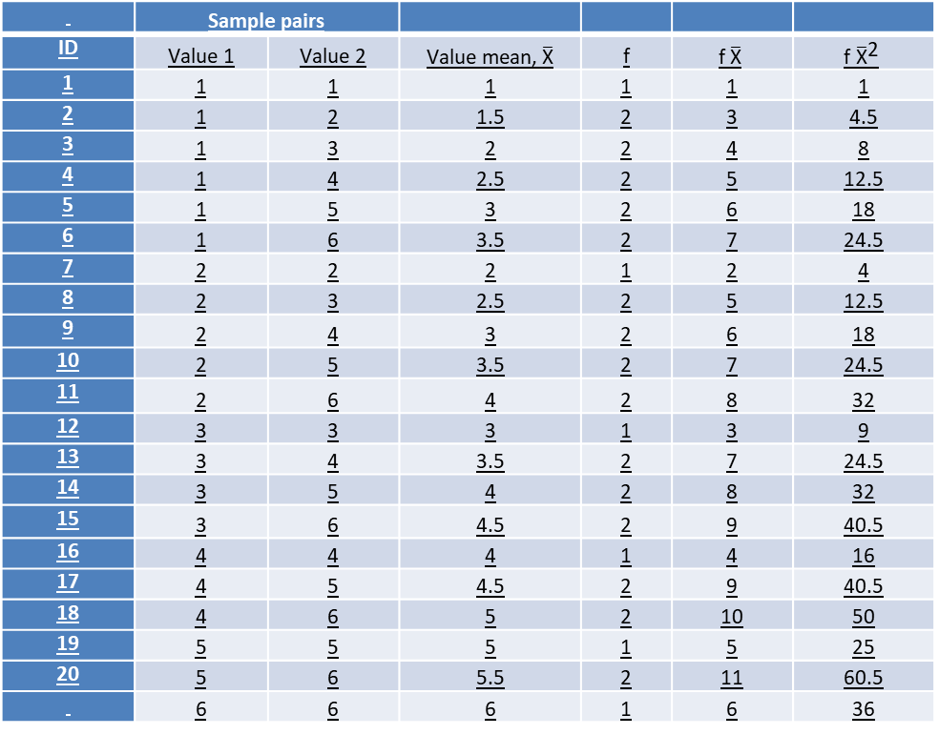
Example 4.5 (2/7)
If we now sample all possible samples of size 2 (n = 2) from the population with replacement from this population.
Then we would have 36 (N² = 6² = 36) possible samples of size n = 2 from a population of size N = 6.
 | Sample pairs
ID | Value 1 | Value 2 | Value mean, $\overline{\text{X}}$ | f | $$\text{f} \overline{\text{X}}$$ | $$\text{f} {\overline{\text{X}}}^{\text{2}}$$
1 | 1 | 1 | 1 | 1 | 1 | 1
2 | 1 | 2 | 1.5 | 2 | 3 | 4.5
3 | 1 | 3 | 2 | 2 | 4 | 8
4 | 1 | 4 | 2.5 | 2 | 5 | 12.5
5 | 1 | 5 | 3 | 2 | 6 | 18
6 | 1 | 6 | 3.5 | 2 | 7 | 24.5
7 | 2 | 2 | 2 | 1 | 2 | 4
8 | 2 | 3 | 2.5 | 2 | 5 | 12.5
9 | 2 | 4 | 3 | 2 | 6 | 18
10 | 2 | 5 | 3.5 | 2 | 7 | 24.5
11 | 2 | 6 | 4 | 2 | 8 | 32
12 | 3 | 3 | 3 | 1 | 3 | 9
13 | 3 | 4 | 3.5 | 2 | 7 | 24.5
14 | 3 | 5 | 4 | 2 | 8 | 32
15 | 3 | 6 | 4.5 | 2 | 9 | 40.5
16 | 4 | 4 | 4 | 1 | 4 | 16
17 | 4 | 5 | 4.5 | 2 | 9 | 40.5
18 | 4 | 6 | 5 | 2 | 10 | 50
19 | 5 | 5 | 5 | 1 | 5 | 25
20 | 5 | 6 | 5.5 | 2 | 11 | 60.5
 | 6 | 6 | 6 | 1 | 6 | 36

Slide 12
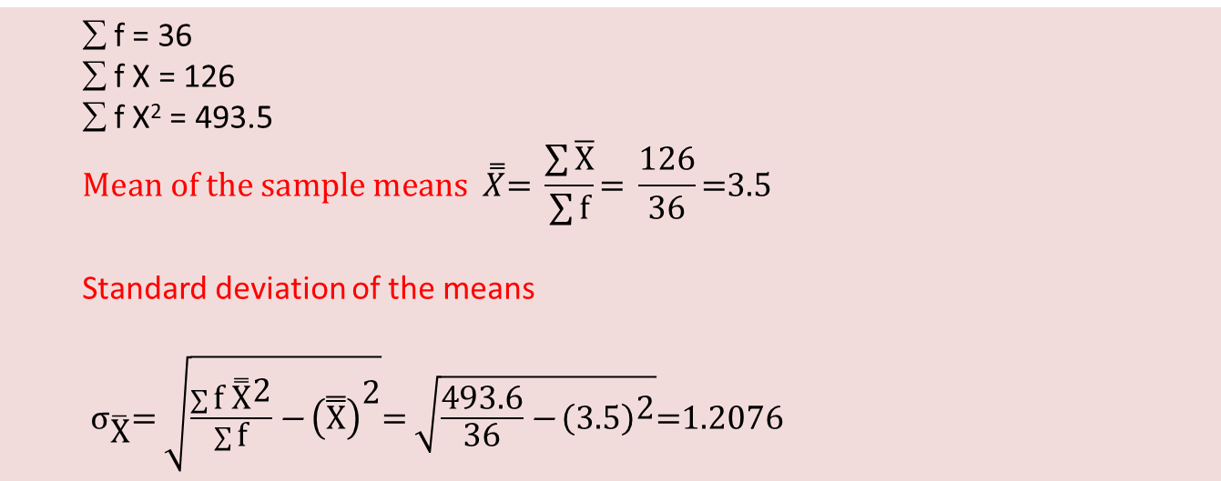
Example 4.5 (3/7)
We can calculate the mean of these sample means and corresponding standard deviation of the sample means using the table 4.3 frequency distribution. For example, sample pair (2, 6) the sample mean is equal to 4. The frequency of the (2, 6) occurs twice given we can have (2, 6) or (6, 2).
∑ f = 36
∑ f X = 126
∑ f X² = 493.5
$$\text{Mean} \text{of} \text{the} \text{sample} \text{means} \overset{̿}{X}\text{= }\frac{\sum{\overline{\text{X}}}}{\sum{\text{f}}}\text{= }\frac{\text{126}}{\text{36}}\text{=3.5}$$
Standard deviation of the means
${\text{σ}}_{\overline{\text{X}}}\text{= }\sqrt{\frac{\sum{\text{f} {\overset{̿}{\text{X}}}^{\text{2}}}}{\sum{\text{f}}}\text{−} {\left(\overset{̿}{\text{X}}\right)}^{\text{2}}}\text{= }\sqrt{\frac{\text{493.6}}{\text{36}}\text{−} {\left(\text{3.5}\right)}^{\text{2}}}\text{=1.2076}$

Slide 13

Example 4.5 (4/7)
Observation 1:
The population mean μ = 3.5
The mean of the sample means = 3.5
The mean of the sample means is an unbiased estimator of the population mean

Slide 14



Example 4.5 (5/7)
Observation 2:
The population standard deviation σ = 1.7078
The standard deviation of the sample means = 1.2076
The standard deviation of the sample means is a biased estimate of the population
standard deviation (σ ≠ ).
It can be shown that the relationship between sample and population is represented by equation (4.7)

Slide 15
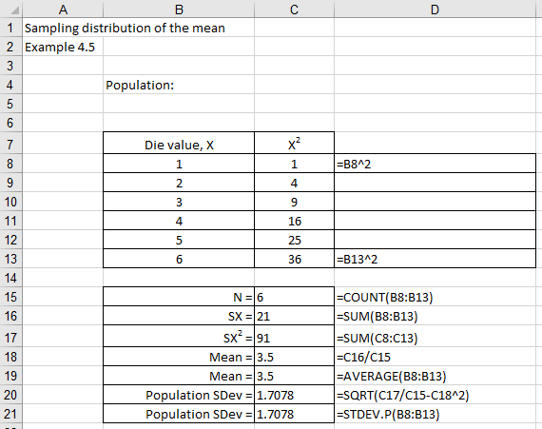
Excel solution

Slide 16
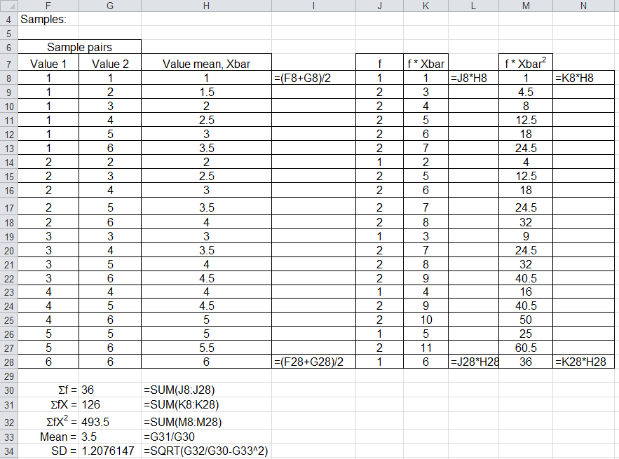
Excel solution continued

Slide 17
Conclusions
We observe from these results:
The overall sample mean is equal to the population mean and is called an unbiased estimator of the population mean. Different samples of the same size from the same population will have different sample mean values.
The standard deviation of the sample means is not equal to the population standard deviation and is called a biased estimator of the population standard deviation.
We can show that the relationship between the sample of size n and population standard deviation is represented by Equation (6.5):
This is called the standard error of the mean

Slide 18
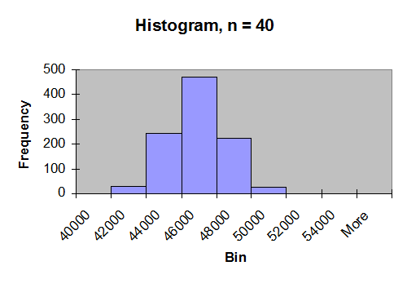
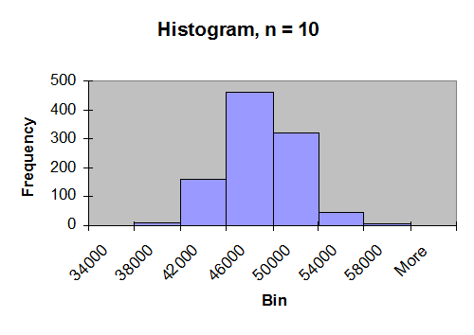
Sampling from a normal population
If we select a random variable X from a population that is normally distributed with population mean µ and standard deviation σ then we can state this relationship using the notation X ~ N(µ, σ²).
If we now sample 1000 data points from this population where each sample is of size n then we observe that the sampling distributions of the mean is approximately normal for sample distributions of size n = 40, and 10. From the histograms we observe that the sample means are less spread out about the mean as the sample sizes increase.
From these observations we conclude: If a population is normal with mean µ and standard deviation σ, the sampling distribution of the mean is normally distributed with

Slide 19
Example 4.7 (1/3)
“Diet X” runs several weight reduction centres within a large town in the north east of England.
From the historical data it was found that the weight of participants is normally distributed with a mean of 150 pounds and a standard deviation of 30 pounds.
This can be written in mathematical notation as X~N (150, 30²).
Calculate the probability that the average sample weight is greater than 160 pounds when 25 participants are randomly selected for the sample.
Solve

Slide 20
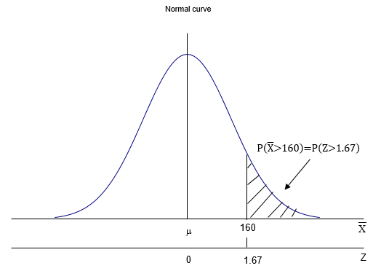


Example 4.7 (2/3)
Figure 4.27 illustrates the region to be found that represents this probability.
From Equation (4.9) we have:
From normal tables
The probability that the sample mean is greater than 160 pounds is 0.04779 or ≈5%.

Slide 21
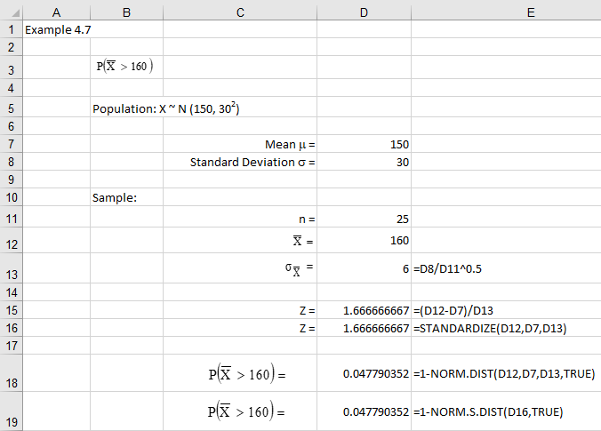
Example 4.7 Excel solution

Slide 22


Example 4.7 SPSS solution
Select Transform > Compute Variable
Name Target Variable: Example4.6
Enter in Numeric Expression: 1-CDF(160,150,6)
Click Ok
SPSS will now undertake the calculation and store the result in the data file under column labelled Example4.6

Slide 23
Sampling from a non-normal population
In the previous section we sampled from a population which is normally distributed and we stated that the sample means will be normally distributed with mean µ and standard error of the mean. What if the data does not come from the normal distribution?
The Central Limit Theorem states that no matter what the shape of the population distribution, the sampling distribution of the means will be approximately normal with increasing sample sizes providing better approximations to the normal distribution.
In most cases the value of n should be at least 30 for non-symmetric distributions and at least 20 for symmetric distributions, before we apply this approximation.
The value of the standard error of the mean will be modified by a correction factor when sampling without replacement from a finite population.

Slide 24
Sampling distribution of the proportion
The sample proportion ρ will be an estimate of the true population value π. The sample proportion ρ has a binomial distribution if we assume:
Sampling with replacement from a finite population
Sampling without replacement from an infinite population
The sampling distribution of the population proportion π can be approximated by a normal distribution if:
π ~ 0.5 (population proportion approximately 0.5)
nπ ≥ 5
n(1-π) ≥ 5
Where:
The value of the standard error of the mean will be modified by a correction factor when sampling without replacement from a finite population.

Slide 25
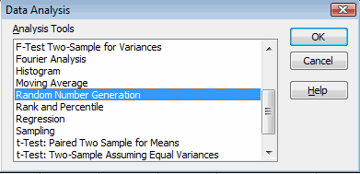
Using Excel to generate a sample (1/5)
Excel can be used to generate random samples from a range of probability distributions, including: Uniform, Normal, Binomial, and Poisson distributions.
Generate ‘n’ samples with ‘N data values (n=10, N=1000)
Select Data > Data Analysis > Random Number Generation

Slide 26
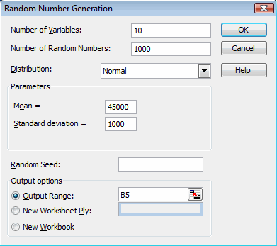
Using Excel to generate a sample (2/5)
In this example we have decided to generate 10 random samples, each of size 1000, from a normal population with mean 45000 and standard deviation 1000.
μ = 45000, σ = 1000
The ‘n’ samples are located in the rows of the table of values, e.g. sample 1: B5:K5, sample 2: B6:K6, and sample 1000: B1006:K1006.

Slide 27
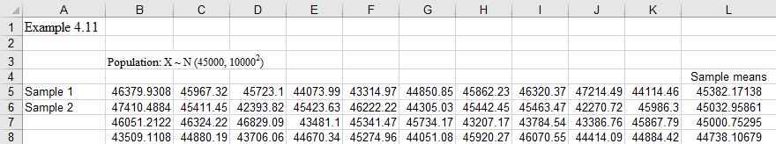
Using Excel to generate a sample (3/5)
Calculate ‘n’ sample means
Calculate the sample mean using Excel function =AVERAGE(), e.g. from sample 1: mean =AVERAGE(B5:K5), sample 2: mean =AVERAGE(B6:K6), and sample 1000: mean =AVERAGE(B1006:K1006).

Slide 28
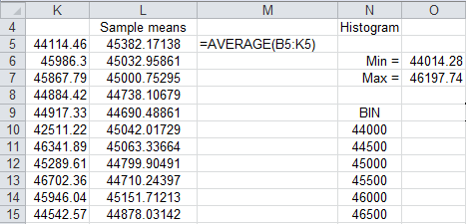
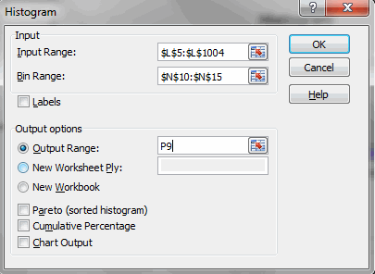
Using Excel to generate a sample (4/5)
Create histogram bins and plot histogram of sample means
Select Data > Data Analysis > Histogram

Slide 29
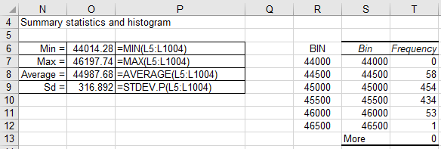
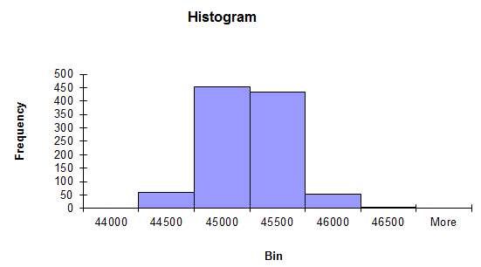
Using Excel to generate a sample (5/5)
From the histogram we note that the histogram values are centered about the population mean value of €45,000. If we repeated this exercise from different values of sample size ‘n’ we would find that the range would reduce as the sample sizes increase.
From Excel, the overall mean value of all 1000 sample means gives a mean of 44988 with a standard deviation of 317.

Slide 30


Using SPSS to generate a sample
We can use SPSS to recreate the sampling distribution
Create the data values X1, X2, …., X10
Name the first column X1.
Enter a number (any) in the 1000th cell of the first column to define the variable size (that is the size of the sample). If you have a problem with be able to select the 1000th value, then create the 1000 case data values in Excel and copy to the SPSS data file.

Slide 31

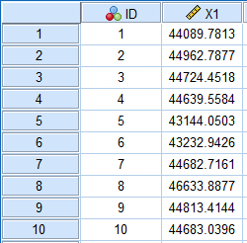
Using SPSS to generate a sample
Now create the sample values in column X1 using Transform > Compute Variable
Name Target Variable: X1
Enter in Numeric Expression: RV.NORMAL(45000, 1000)
Click OK
SPSS will now undertake the calculation and store the result in the data file under column labelled X1 (first 10 values out of 1000 illustrated).

Slide 32
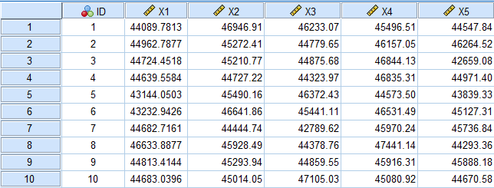


Using SPSS to generate a sample
Since we have 10 samples then we need to repeat this calculation for X1, X2, …., X10. The first 10 values for X1, X2, …., X5 out of the 10 samples are ILLUSTRATED.
Calculate the average values for each of the 1000 samples of size 10
The first 3 average values are

Slide 33
Using SPSS to generate a sample continued
Calculate the overall Xbar mean and standard deviation and construct the histogram using Analyze > Descriptive Statistics > Frequencies.
Transfer Xbar to the Variables box
Uncheck Display frequency tables (ignore the warning)
Click on Charts and select Histogram
Click Continue
Click on Statistics and select Mean, Std. deviation
Click Continue
Click Ok

Slide 34
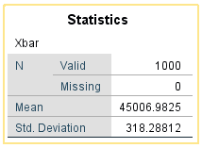
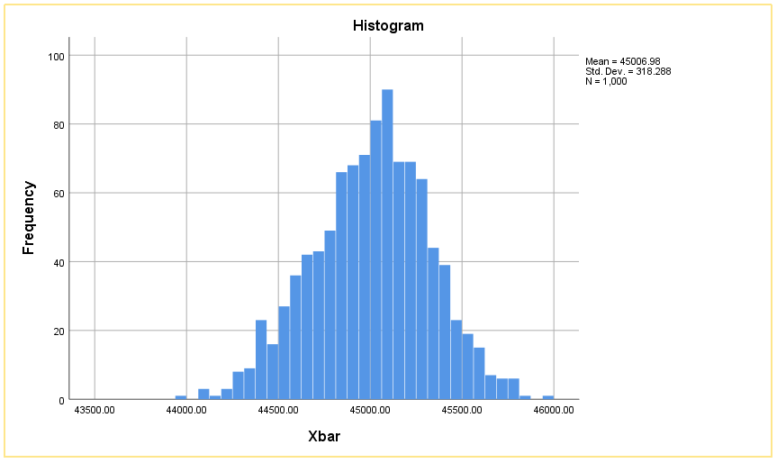
Using SPSS to generate a sample continued
Summary statistics
From SPSS, the overall mean value of all 1000 sample means gives a mean of 45006 with a standard deviation of 318.
Histogram
The histogram shows a fairly normally distributed distribution for the sample means.

Slide 35
Conclusion
In this presentation we explored the concept of a sampling data values from a population:
Sampling from a population

